Slide 1
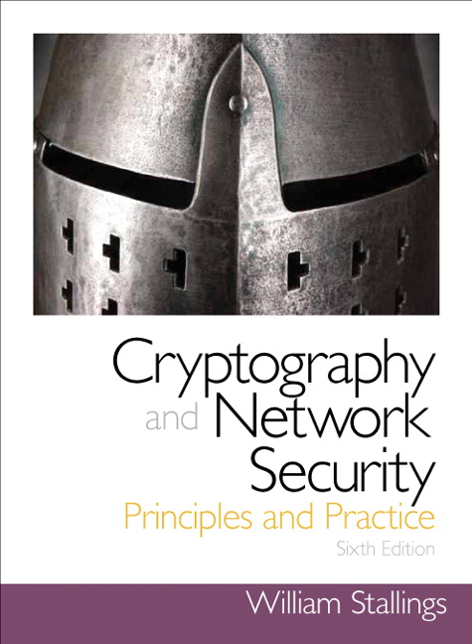
Security
MACs and Digital Signatures
R. Brooks

Slide 2
Security Services
Confidentiality
Information is kept secret from all but the authorized parties
Authenticity x 3
Message Authentication: The sender of a message is authentic
Message Integrity: Message has not been modified during transmission
Nonrepudiation*: The sender of the message cannot deny the creation of the message/having sent/signed the message
* We also have receiver nonrepudiation

Slide 3
Message Authentication
message authentication is concerned with:
protecting the integrity of a message
validating identity of originator
non-repudiation of origin (dispute resolution)
will consider the security requirements
then three alternative functions used:
hash function
message encryption
message authentication code (MAC)

Slide 4
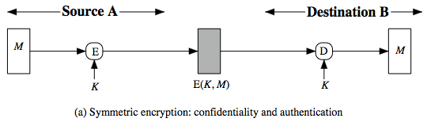
Symmetric Message Encryption
encryption can also provides authentication
if symmetric encryption is used then:
receiver know sender must have created it
since only sender and receiver now key used
know content cannot of been altered
if message has suitable structure, redundancy or a checksum to detect any changes

Slide 5
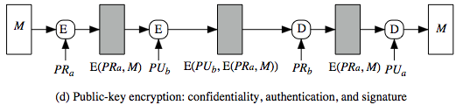
Public-Key Message Encryption
if public-key encryption is used:
encryption provides no confidence of sender
since anyone potentially knows public-key
however if
sender signs message using their private-key
then encrypts with recipients public key
have both secrecy and authentication
again need to recognize corrupted messages
but at cost of two public-key uses on message

Slide 6
Message Authentication Code (MAC)
generated by an algorithm that creates a small fixed-sized block
depending on both message and some key
like encryption though need not be reversible
appended to message as a signature
receiver performs same computation on message and checks it matches the MAC
provides assurance that message is unaltered and comes from sender
Sender and receiver shares symmetric key

Slide 7
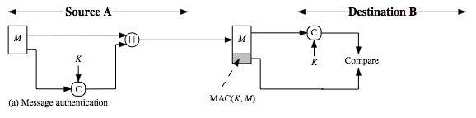
Message Authentication Code
a small fixed-sized block of data
generated from message + secret key
MAC = C(K,M)
appended to message when sent

Slide 8
Message Authentication Codes
as shown the MAC provides authentication
can also use encryption for secrecy
generally use separate keys for each
can compute MAC either before or after encryption
is generally regarded as better done before
why use a MAC?
sometimes only authentication is needed
sometimes need authentication to persist longer than the encryption (eg. archival use)
note that a MAC is not a digital signature

Slide 9
MAC Properties
a MAC is a cryptographic checksum
MAC = C_{K}(M)
condenses a variable-length message M
using a secret key K
to a fixed-sized authenticator
is a many-to-one function
potentially many messages have same MAC
but finding these needs to be very difficult

Slide 10
Requirements for MACs
taking into account the types of attacks
need the MAC to satisfy the following:
knowing a message and MAC, is infeasible to find another message with same MAC
MACs should be uniformly distributed
MAC should depend equally on all bits of the message

Slide 11
Keyed Hash Functions as MACs
Hash vs. MAC
want a MAC based on a hash function
because hash functions are generally faster
crypto hash function code is widely available
hash includes a key along with message
original proposal:
KeyedHash = Hash(Key|Message)
some weaknesses were found with this
eventually led to development of HMAC

Slide 12
HMAC
specified as Internet standard RFC2104
uses hash function on the message:
HMAC_{K}(M)= Hash[(K⁺ XOR opad) ||
Hash[(K⁺ XOR ipad) || M)] ]
where K⁺ is the key padded out to size
opad, ipad are specified padding constants
overhead is just 3 more hash calculations than the message needs alone
any hash function can be used
eg. MD5, SHA-1, RIPEMD-160, Whirlpool

Slide 13
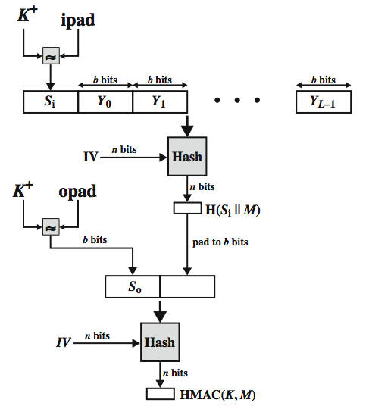
HMAC Overview

Slide 14
Digital Signatures
The most important development from the work on public-key cryptography is the digital signature
Message authentication protects two parties who exchange messages from any third party
However, it does not protect the two parties against each other either fraudulently creating, or denying creation, of a message

Slide 15
Digital Signatures
A digital signature is analogous to the handwritten signature, and provides a set of security capabilities that would be difficult to implement in any other way

Slide 16
Digital Signatures
We just looked at message authentication
This does not address issues of lack of trust
Digital signatures provide the ability to:
Verify author, date & time of signature
Authenticate message contents
Be verified by third parties to resolve disputes
Hence include authentication function with additional capabilities

Slide 17
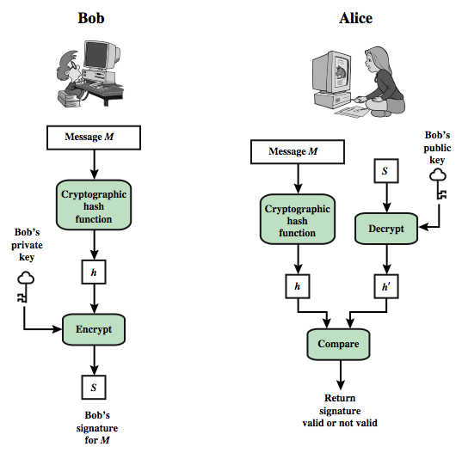
Digital Signature Model

Slide 18
Digital Signature Requirements
Must depend on the message signed
Must use information unique to sender
to prevent both forgery and denial
Must be relatively easy to produce
Must be relatively easy to recognize & verify
Be computationally infeasible to forge
with new message for existing digital signature
with fraudulent digital signature for given message
Be practical save digital signature in storage

Slide 19
Direct Digital Signatures
Involve only sender & receiver
Assumed receiver has sender’s public-key
Digital signature made by sender signing entire message or hash with private-key
Can encrypt using receivers public-key
Important that sign first then encrypt message & signature
Security depends on sender’s private-key

Slide 20
Message Authentication
A secure digital signature scheme, like a secure conventional signature can provide message authentication.
A digital signature provides message authentication.

Slide 21
Message Integrity
The integrity of the message is preserved even if we sign the whole message because we cannot get the same signature if the message is changed.
A digital signature provides message integrity

Slide 22
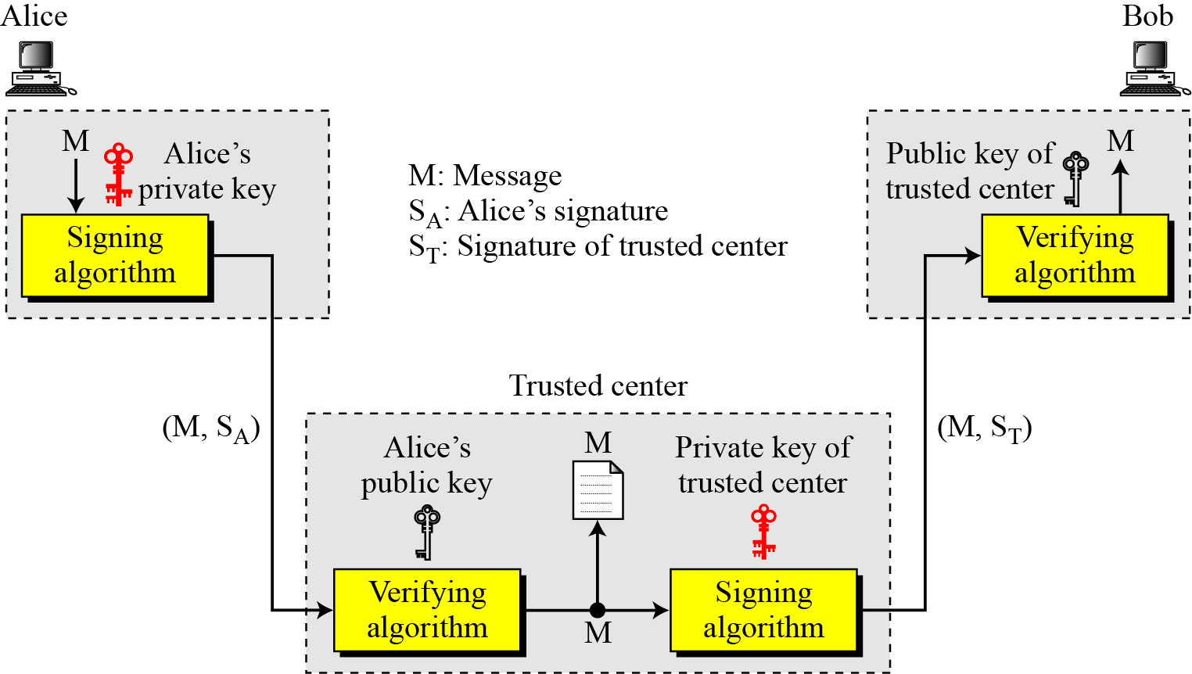
Nonrepudiation
Using a trusted center for nonrepudiation
Nonrepudiation can be provided using a trusted party.

Slide 23
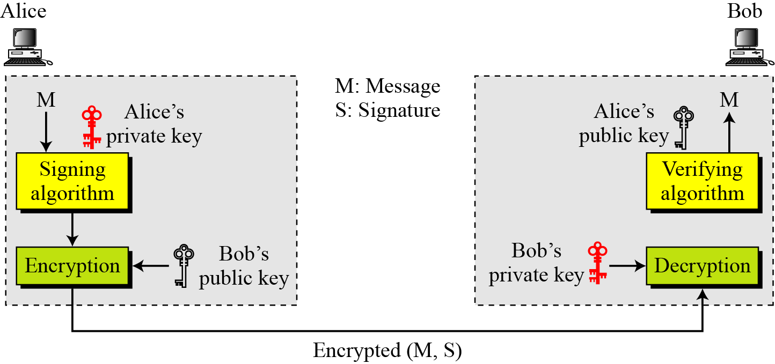
Confidentiality
Adding confidentiality to a digital signature scheme
A digital signature does not provide privacy.
If there is a need for privacy, another layer of encryption/decryption must be applied.

Slide 24
Schnorr Digital Signatures
Also uses exponentiation in a finite (Galois)
security based on discrete logarithms, as in D-H
Minimizes message dependent computation
multiplying a 2n-bit integer with an n-bit integer
Main work can be done in idle time
Have using a prime modulus p
p–1 has a prime factor q of appropriate size
typically p 1024-bit and q 160-bit numbers

Slide 25
Schnorr Key Setup
The first part of this scheme is the generation of a private/public key pair, which consists of the following steps:
Choose primes p and q, such that q is a prime factor of p – 1
Choose an integer a such that a^{q} = 1 mod p
The values a, p, and q comprise a global public key that can be common to a group of users
Choose a random integer s with 0 < s < q. This is the user's private key
Calculate v = a^{–s} mod p. This is the user's public key

Slide 26
Schnorr Signature
User signs message by
choosing random r with 0<r<q and computing x = a^{r} mod p
concatenate message with x and hash result to computing: e = H(M || x)
computing: y = (r + se) mod q
signature is pair (e, y)
Any other user can verify the signature as follows:
computing: x' = a^{y}v^{e} mod p
verifying that: e = H(M || x’)

